Slide 1
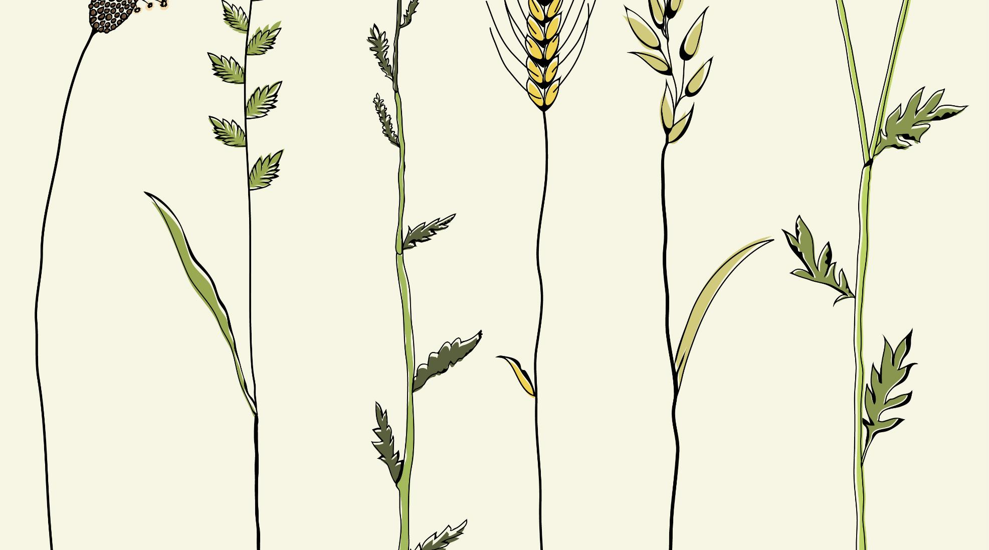

PREPARATION
«MIKOVITAL»
the basis of soil regeneration

Slide 2
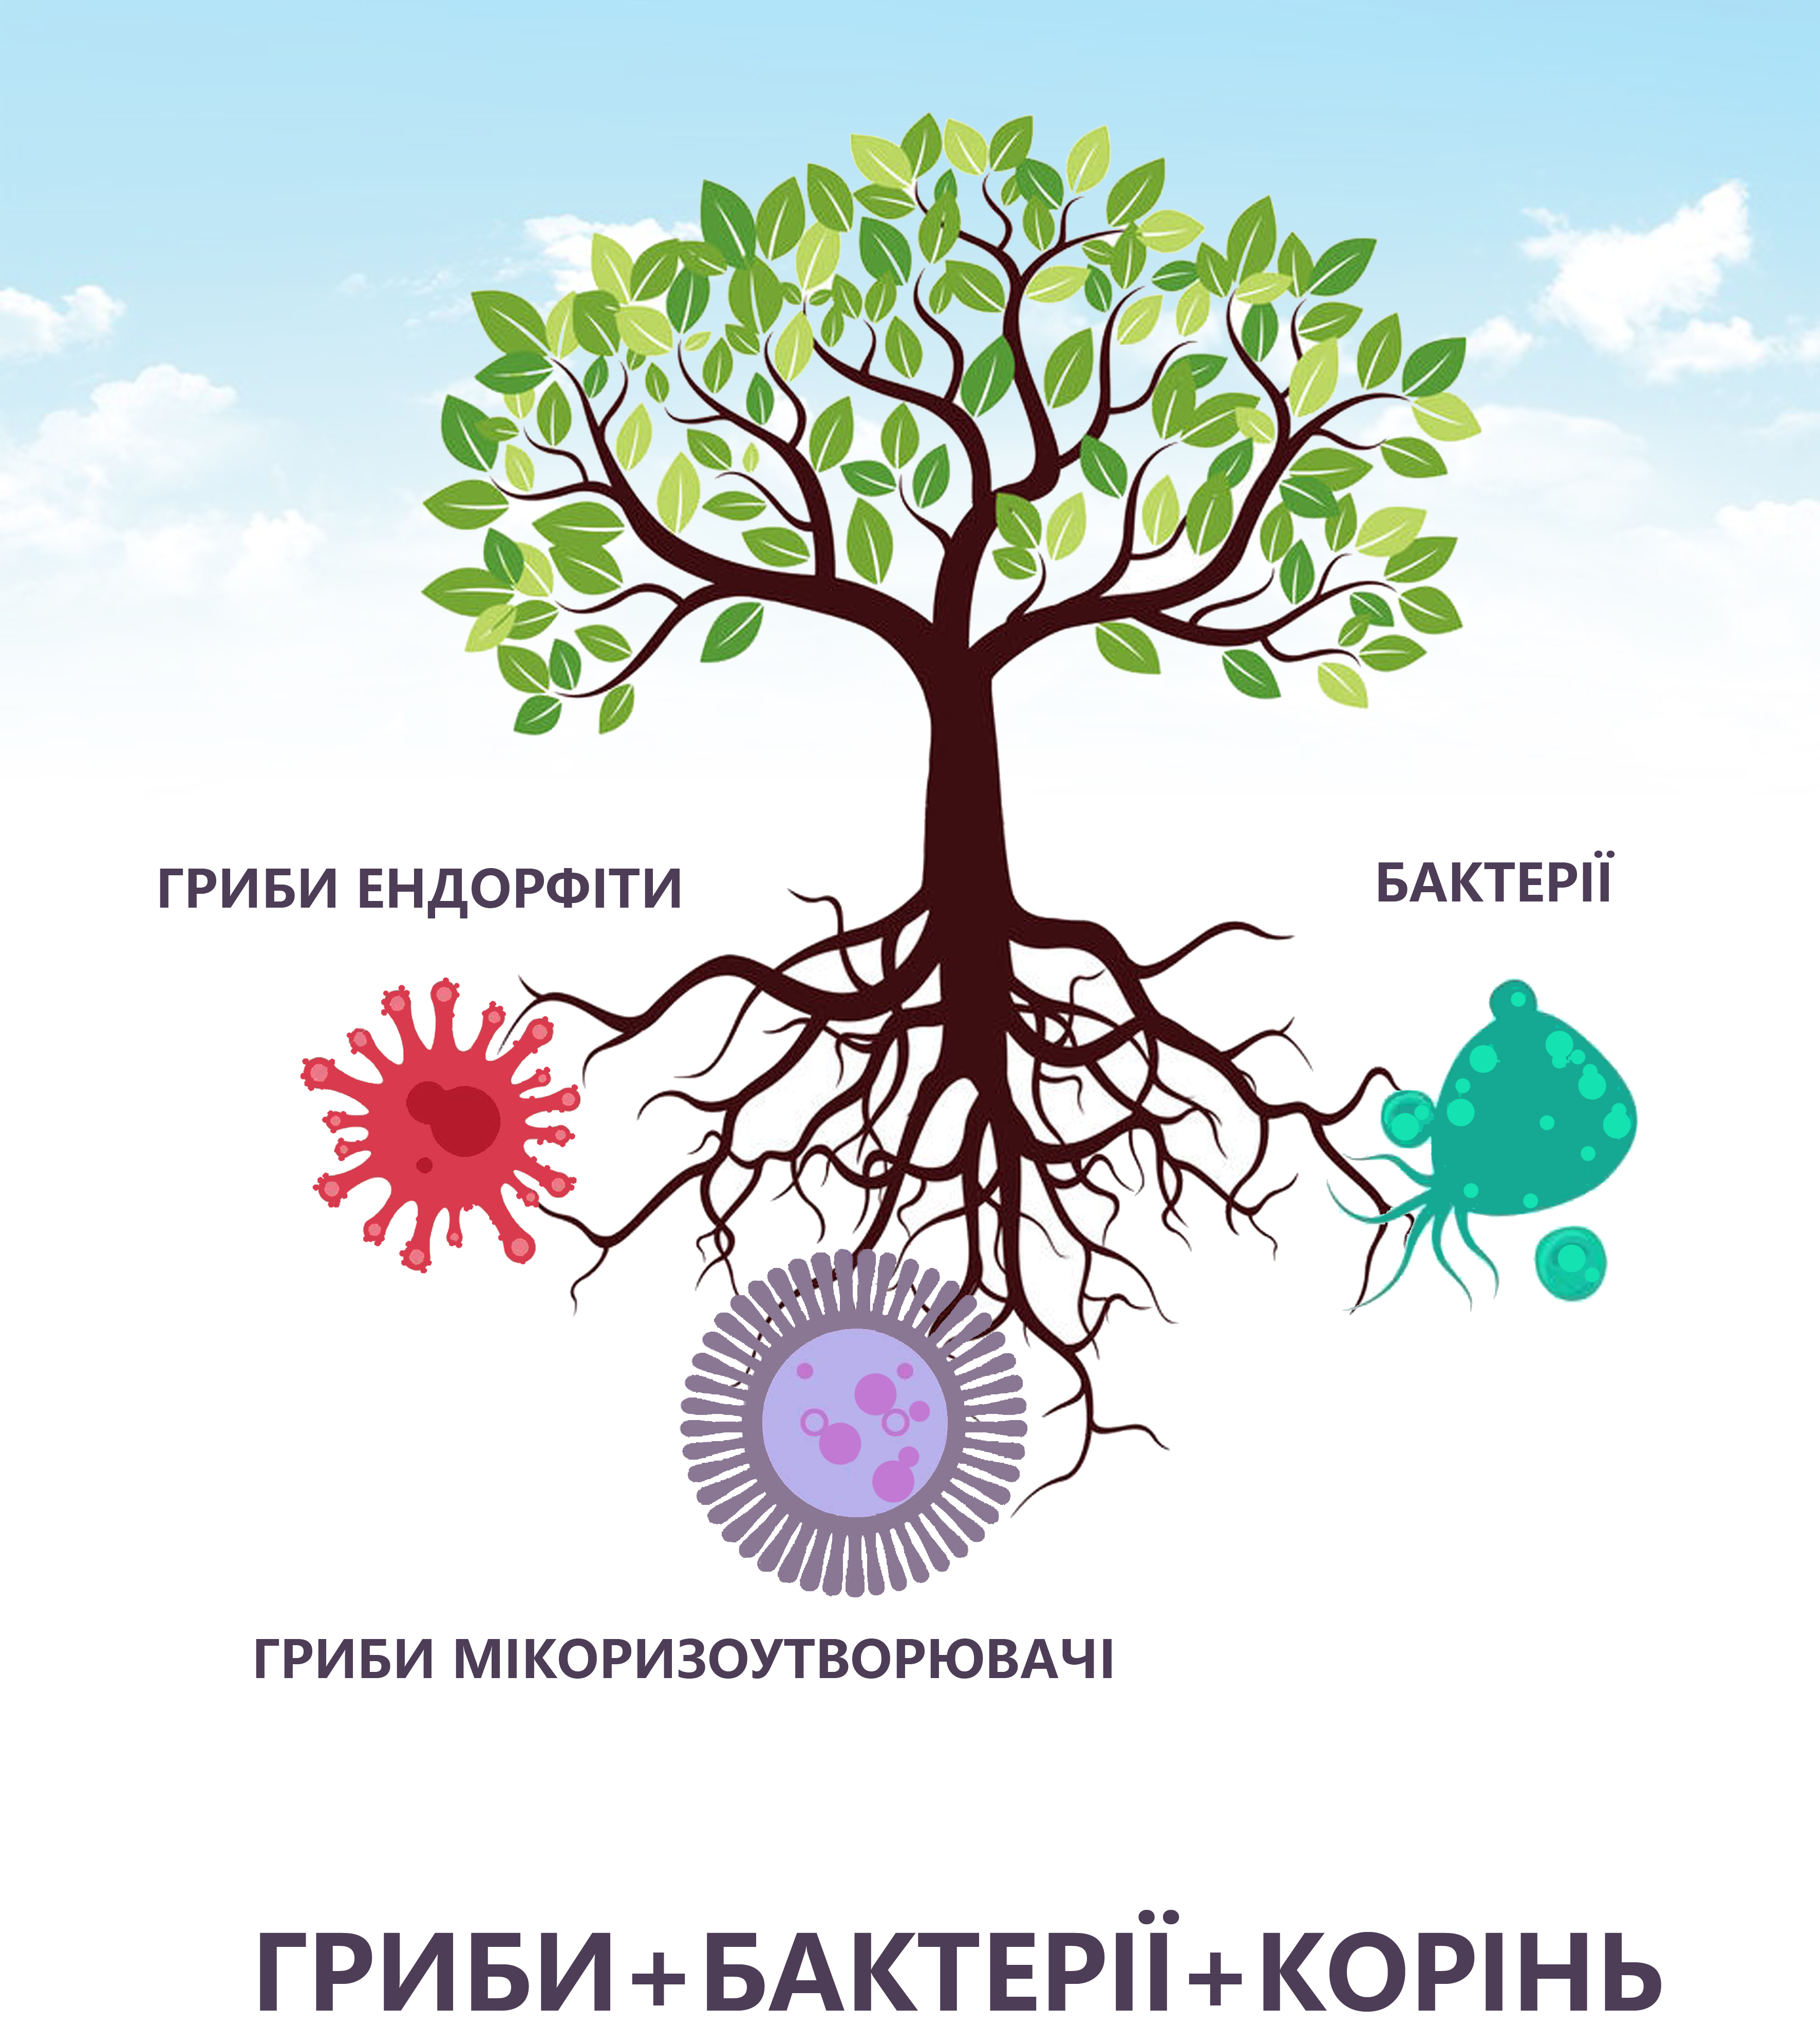
Mycorrhiza: what is it?
Mycorrhysis is an active, mutually beneficial coexistence of fungi, bacteria and plants. In the process of its vital activity, the fungus sends nutrients and moisture to the plant, while the plant supplies sugars and oxygen to the mycelious plant. This is how mycoryosis symbiosis is formed.

Slide 3

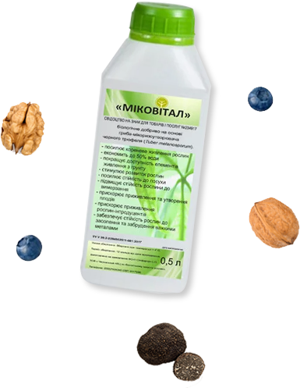



Mikovital contains live vegetative cells of the mycry-forming fungus Tuber melanosporum, as well as biologically active metabolic products of this fungus. These substances stimulate the growth and development of plants and increase their resistance to diseases.
Mikovital is a living mycorrhiza
Increase of harvest
Mycorrizue increases crop yields from 10% to 30% and requires only a single application
Improves power
Fungus helps to assimite hard-to-reach substances from the soil that are necessary for the development of the plant
Certified preparation
Mikovital patented and registered in Ukraine and in "Organic Standard"
Strengthening resilience
Mycorriza increases resistance to drought and frost, as well as other damaging factors
Strengthening resilience
Mycorriza increases resistance to drought and frost, as well as other damaging factors
Taking care of the land
Mikovital not only enhances the plant, it restores the microbiota of your soil

Slide 4
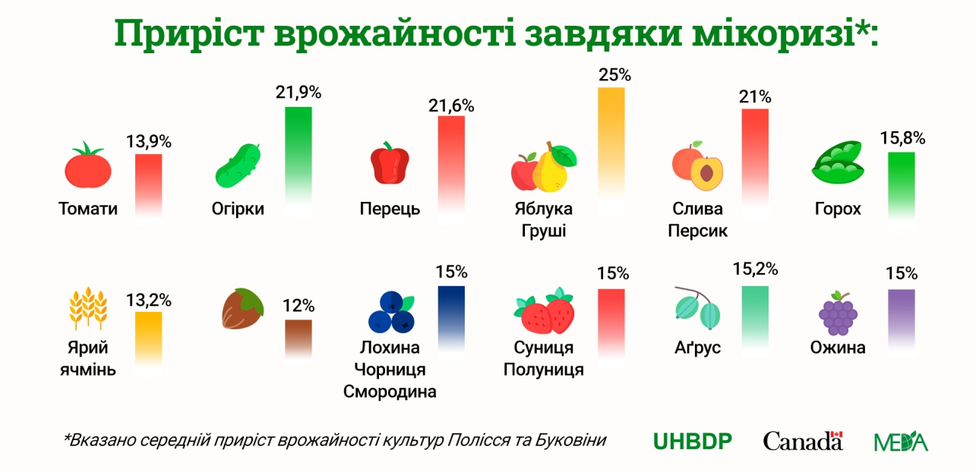
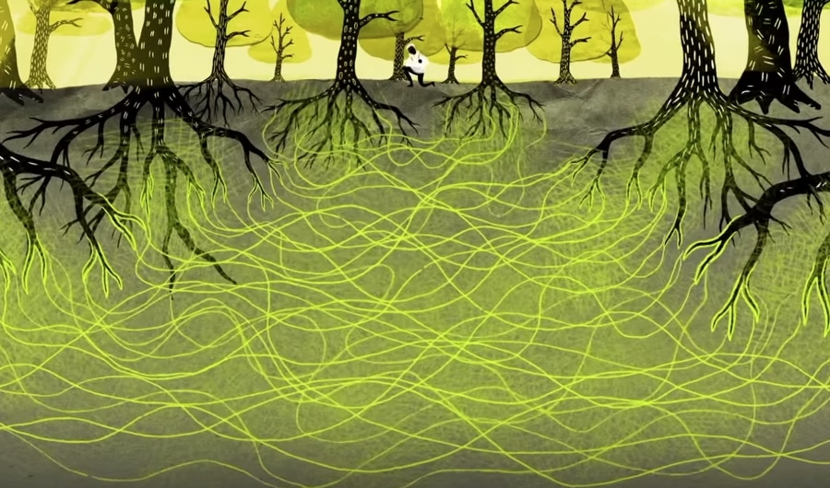
Existing technologies
The common mycorrhizal network ensures the functioning of the Earth
Intensive technology - contributes to the excessive accumulation of nitrates, pollution of the biosphere with nitrogen oxides, through the application of mineral fertilizers, the use of pesticides and pesticides kills the soil mycobiota, especially
nitrogen-fixing microorganisms.
Organic farming - is built on the principle
of being environmentally friendly and provide high and sustainable yields
this year. products.
Regenerative agriculture - creates the transition from intensive technologies to organic farming through the use of biotechnology.
The common mycorrhizal network ensures the functioning of the Earth's ecosystem

Slide 5

The importance of mycorrhiza
Due to excessive use of pesticides, many soils have hardened a useful microbiota, including mycorrhiza.
Because of this, plants cannot fully absorb nutrients and suffer from drought. Returning to the soil,
mycorrhiza quickly attaches to the roots and forms a branched network, which additionally provides
the plant with the necessary trace elements and moisture. It is possible to return mycorrhiza with the help of Mikovital.
This concentrated drug creates mycorrhiza from more than 90% of plants on earth. Since 2010, Mikovital has been successfully and widely used in the fields of Ukraine.
Choosing Mikovital, you are guaranteed to receive advice on its use from the manufacturers .

Slide 6
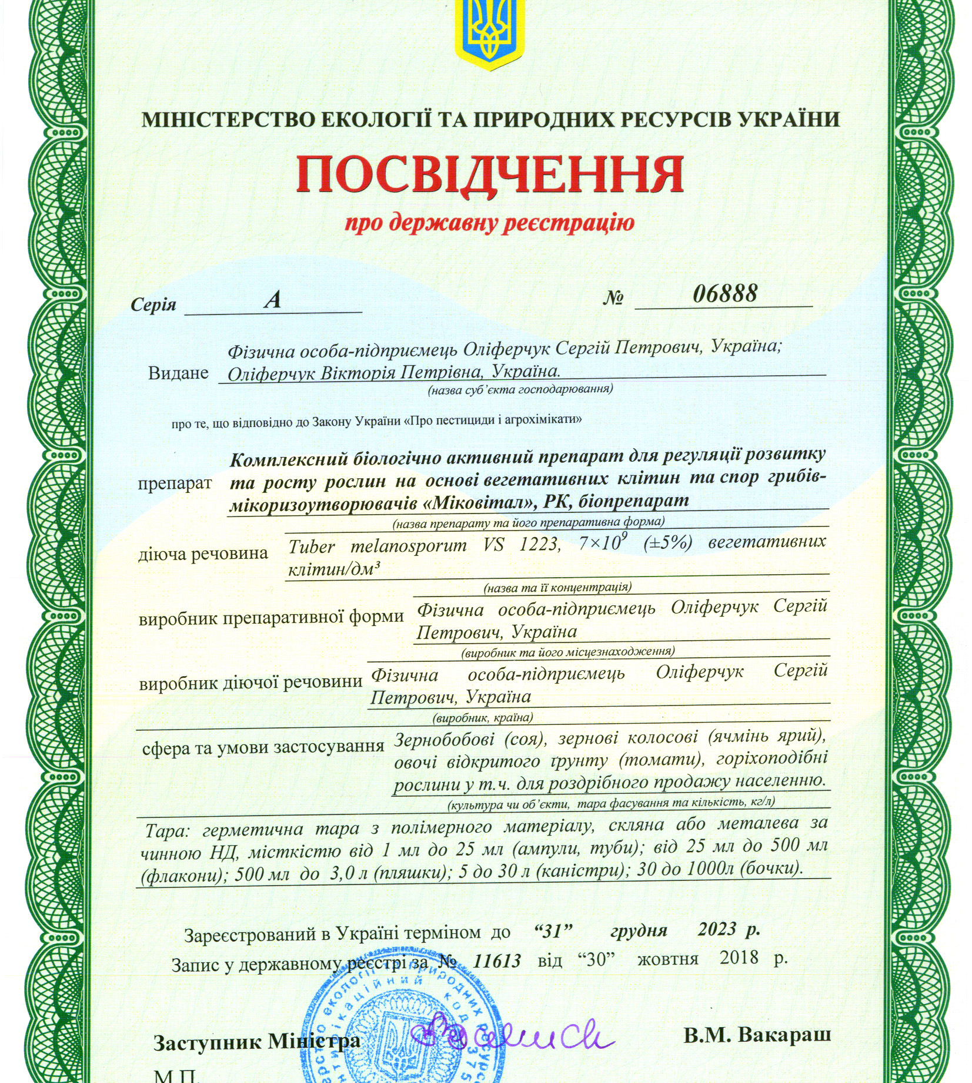
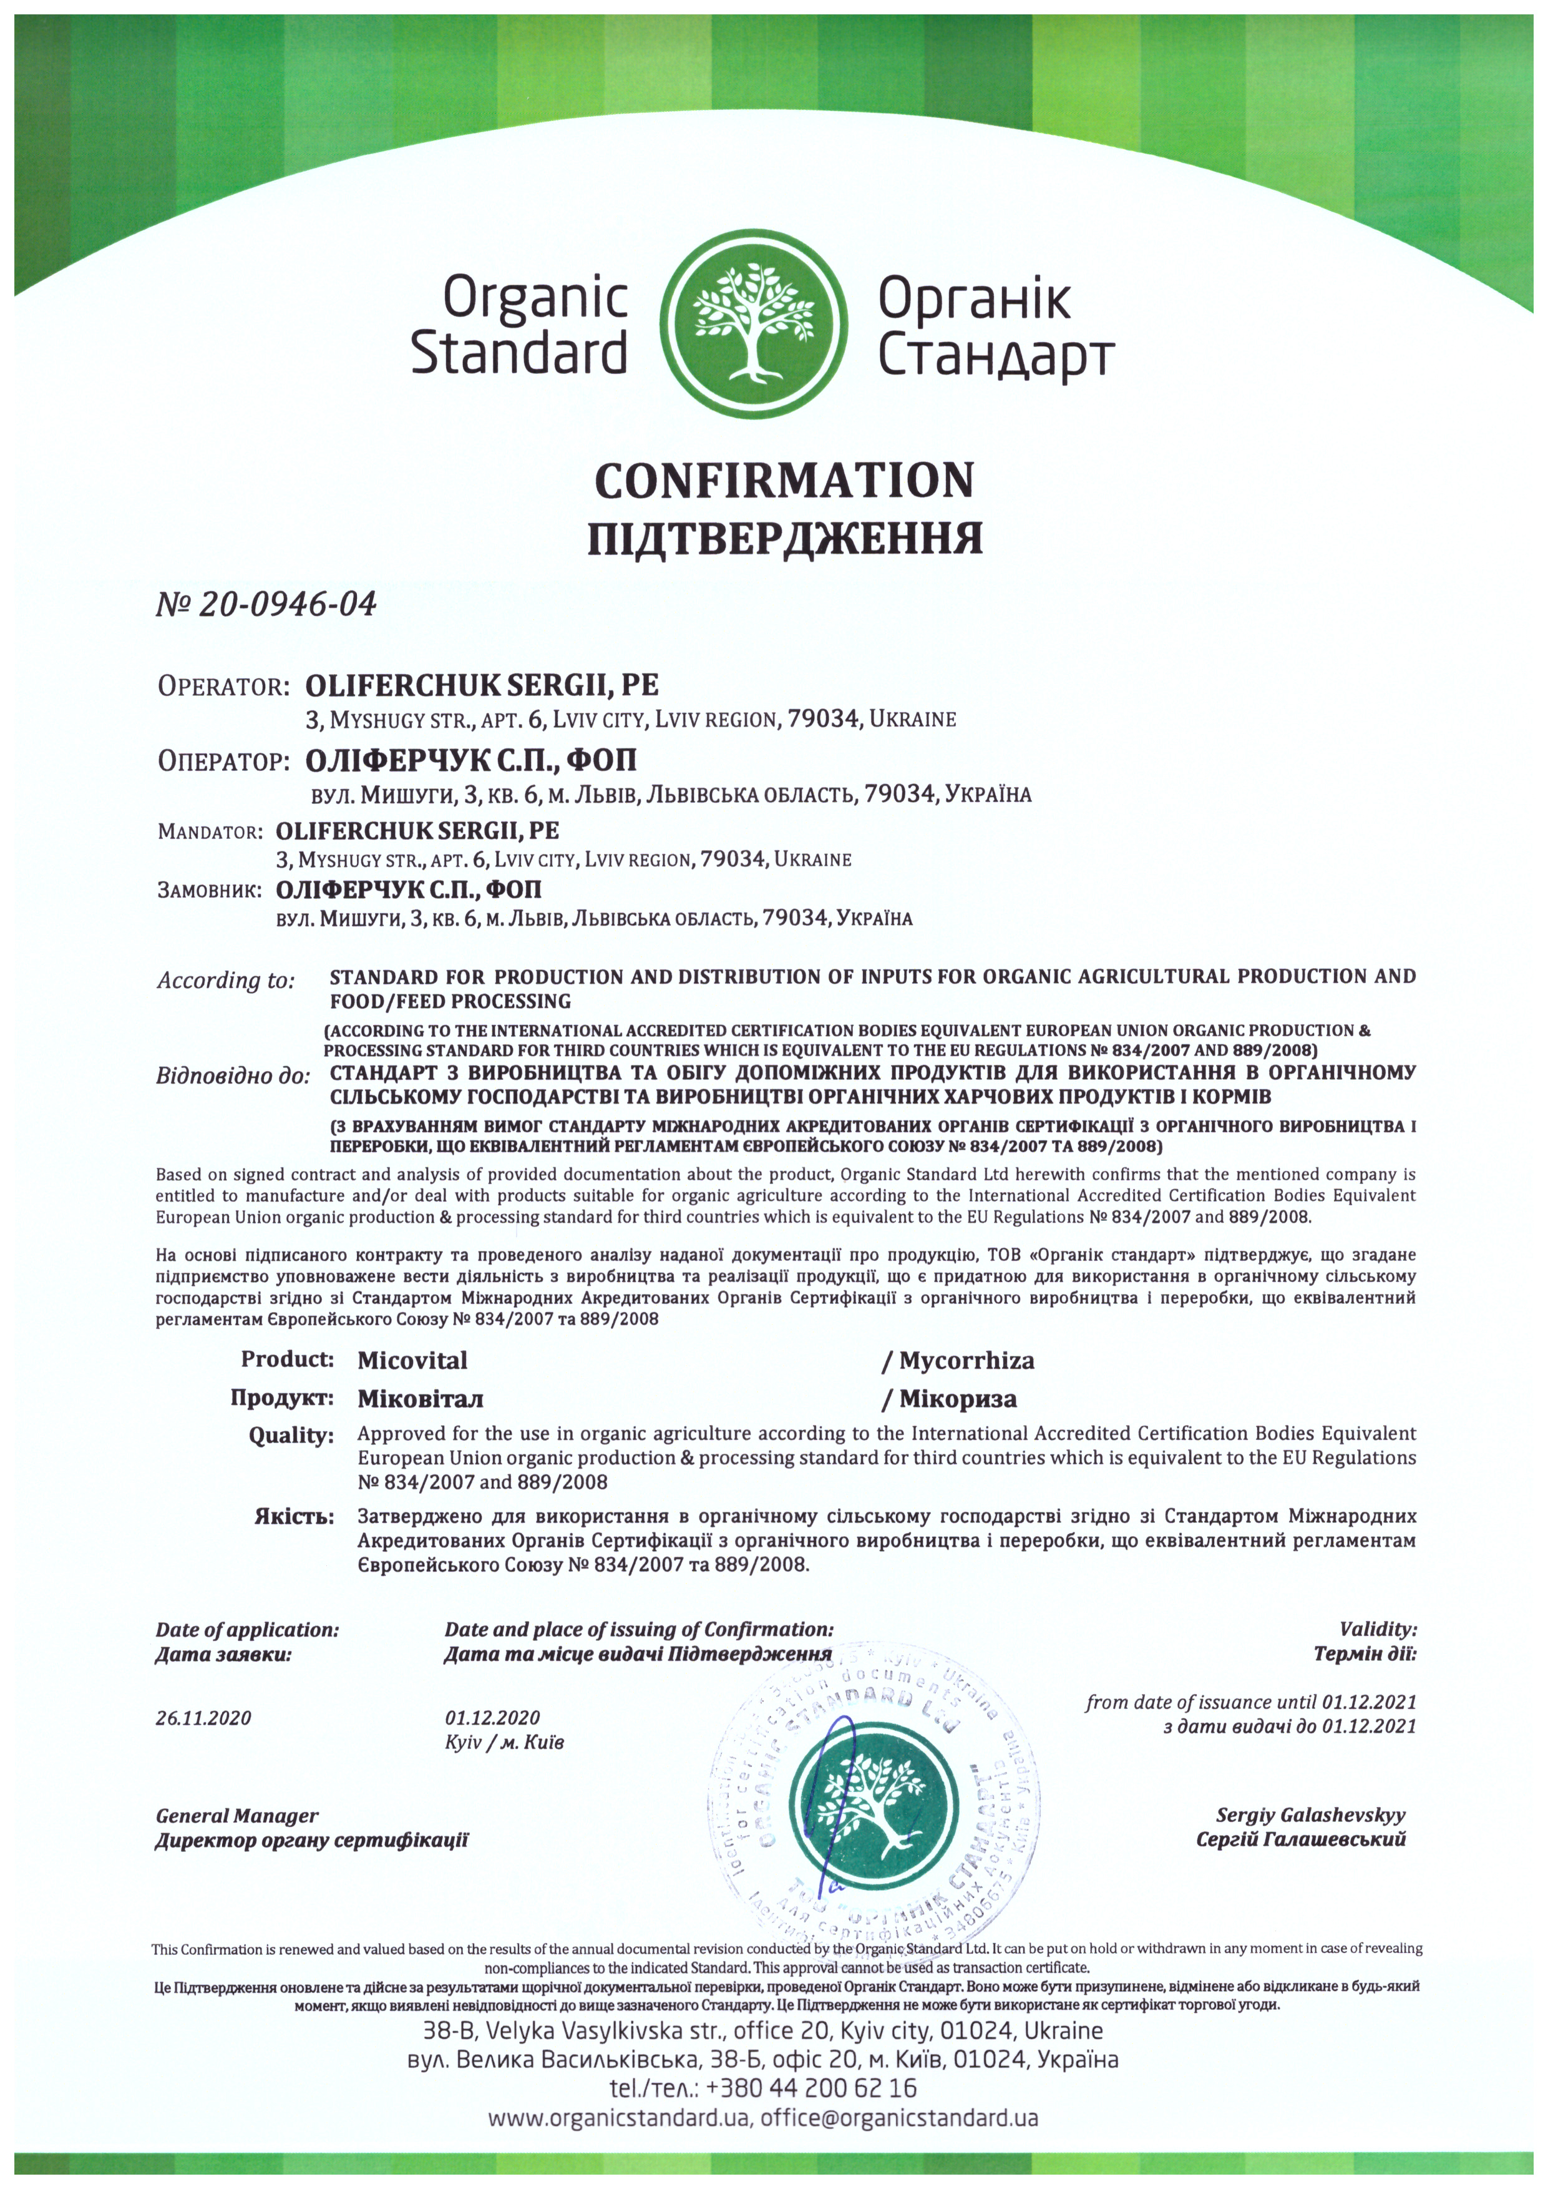

Slide 7
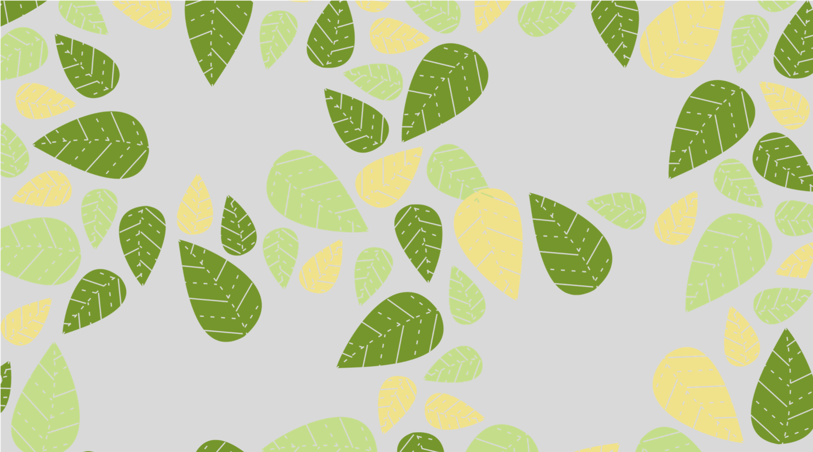




Thank you for your attention!
Thank you for your attention!
Viktoriia Oliferchuk
+3 80986313617
victorijaoliferchuk@gmail.com
www.mikovital.ua

